Slide 1

Tower Hopscotch Project Analysis Group 5
Raphael Emberger
Stefan Bösch
Philipp Meier
Nicolas Eckhart

Slide 2
Project Management
Current iteration #2 will end on Friday
Detailed UC defined, Domain Model created and Project Analysis
Effective time expenditures so far within expected ranges
Overhauled risk list
Next up in iteration #3:
UI prototype developed
Stable architecture defined

Slide 3
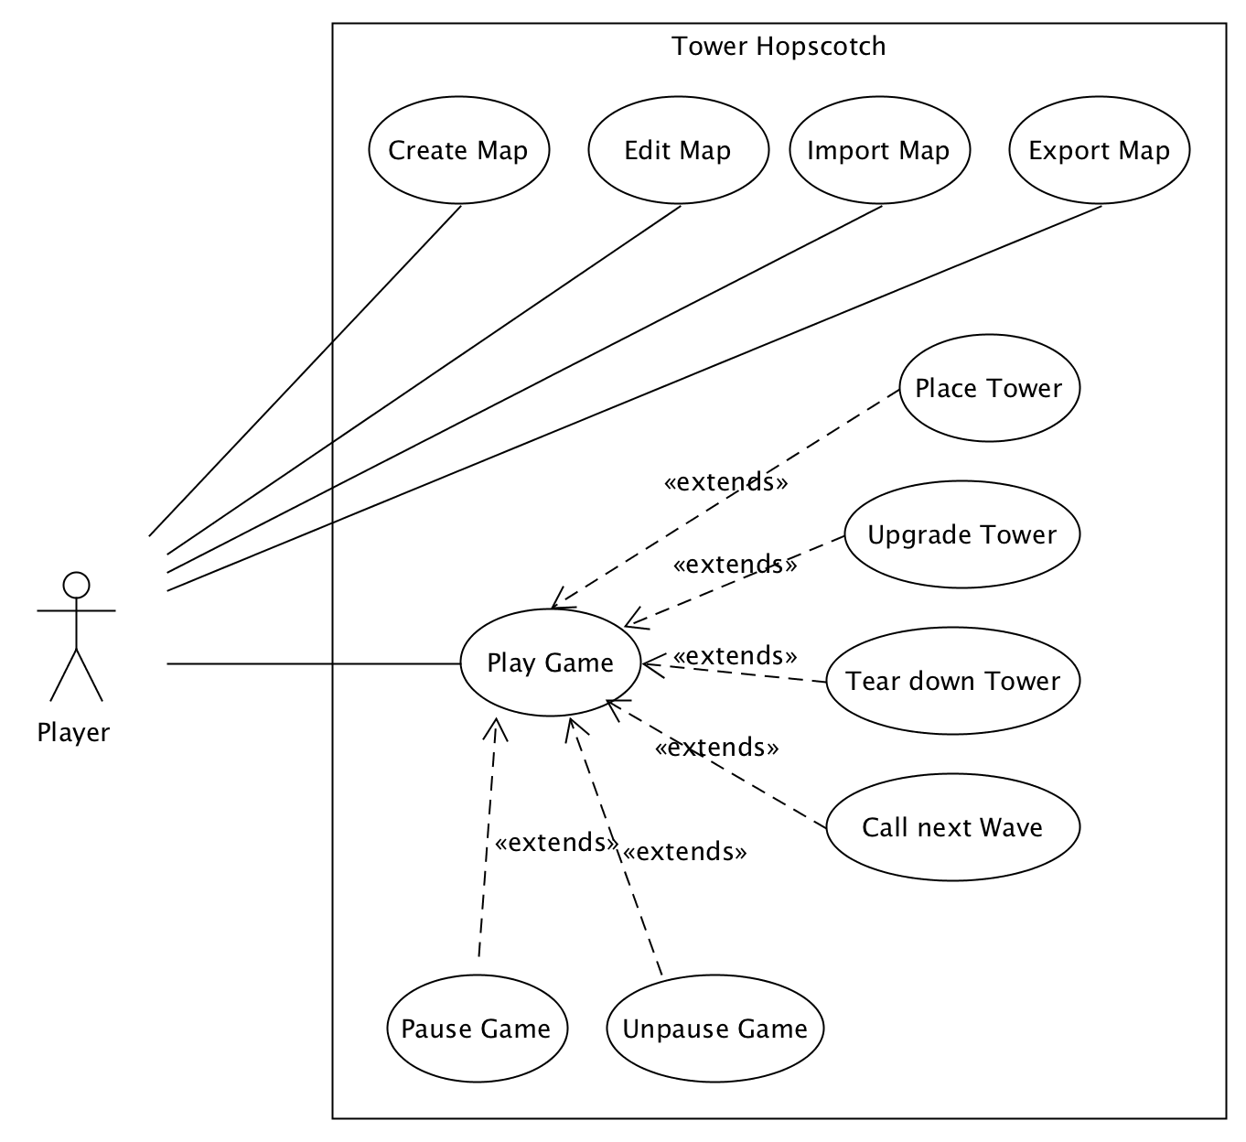
Use Cases
UC 1 Play Game
UC 1.1 Place Tower
UC 1.2 Upgrade Tower
UC 1.3 Tear Down Tower
UC 1.4 Call Next Wave
UC 1.5 Pause Game
UC 1.6 Unpause Game
UC 2 Create Map
UC 3 Edit Map
UC 4 Import Map
UC 5 Export Map

Slide 4
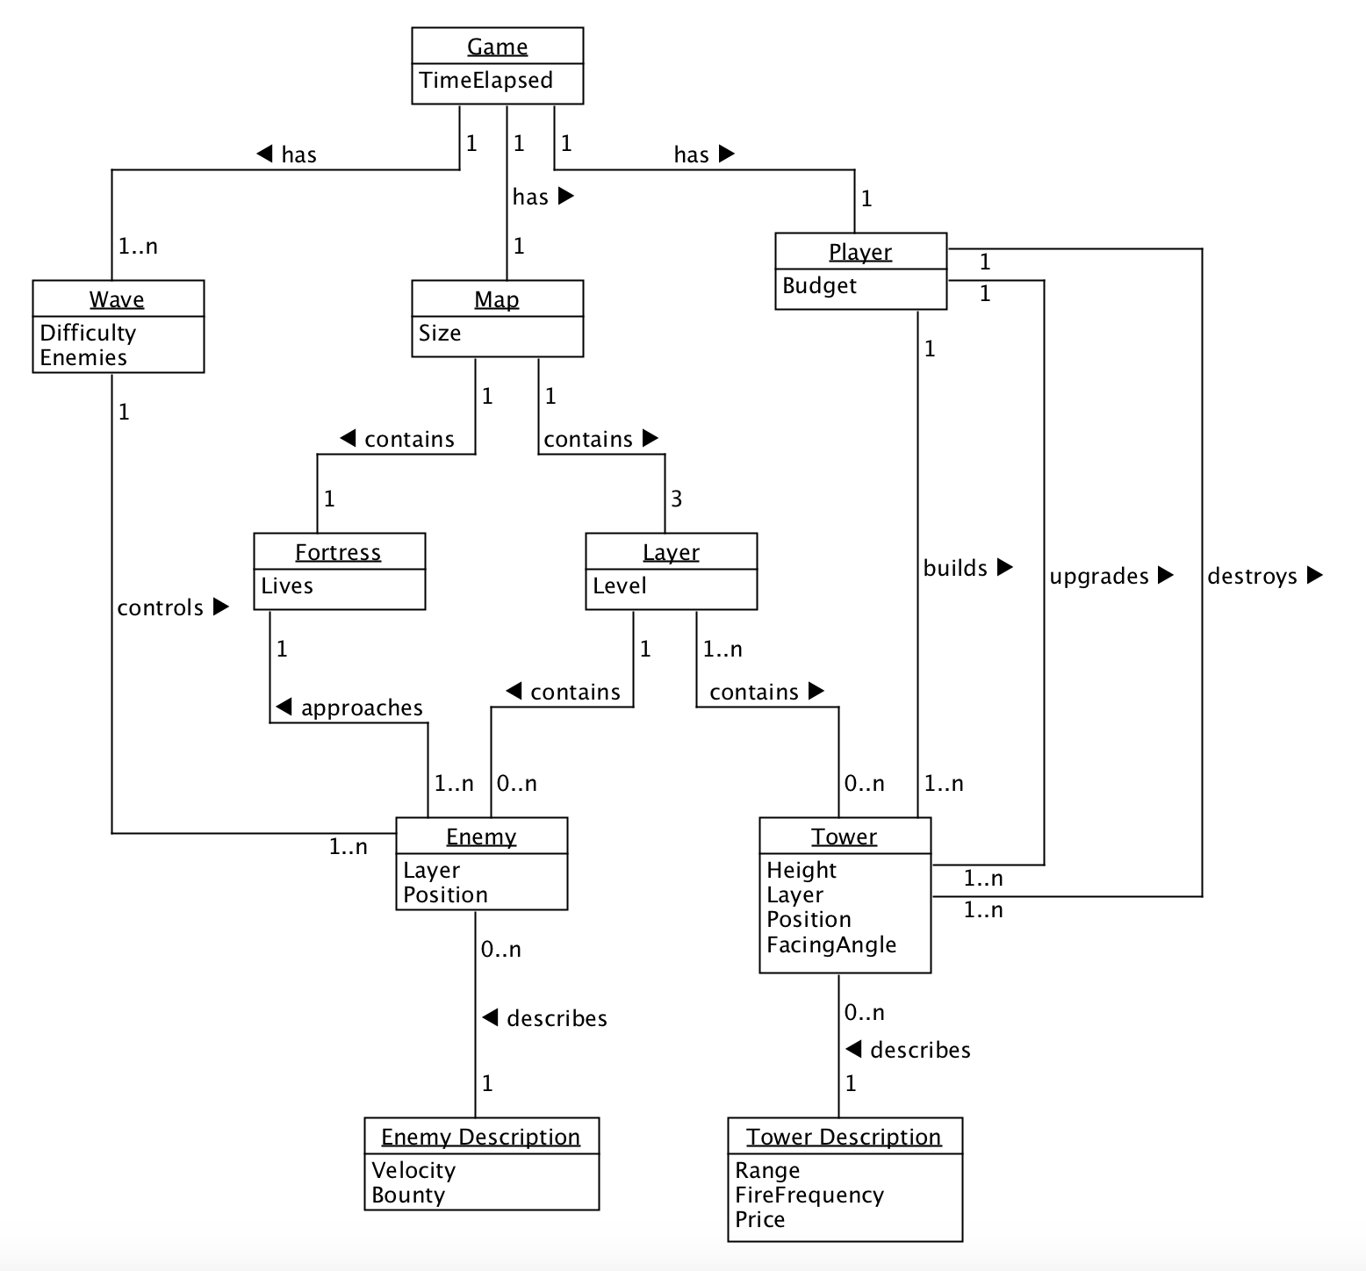
Domain Model
Game
Wave
Player
Map

Slide 5
Additional Specifications
Number | Description | Category
AS1 | The game is supported on Java version 8 and above. | Functionality
AS2 | The game may be played with a mouse or a touch display. | Functionality
AS3 | The program runs on both Mac and Windows computers. | Functionality
AS4 | The application does not crash under normal circumstances. | Reliability
AS5 | Starting the game and loading a map should never take more than a few seconds. | Performance
AS6 | The game should remain at a constant 60 frames per second while playing. | Performance
AS7 | The code meets general quality standards so that it can be maintained or worked on by new developers without effort. | Supportability

Slide 6
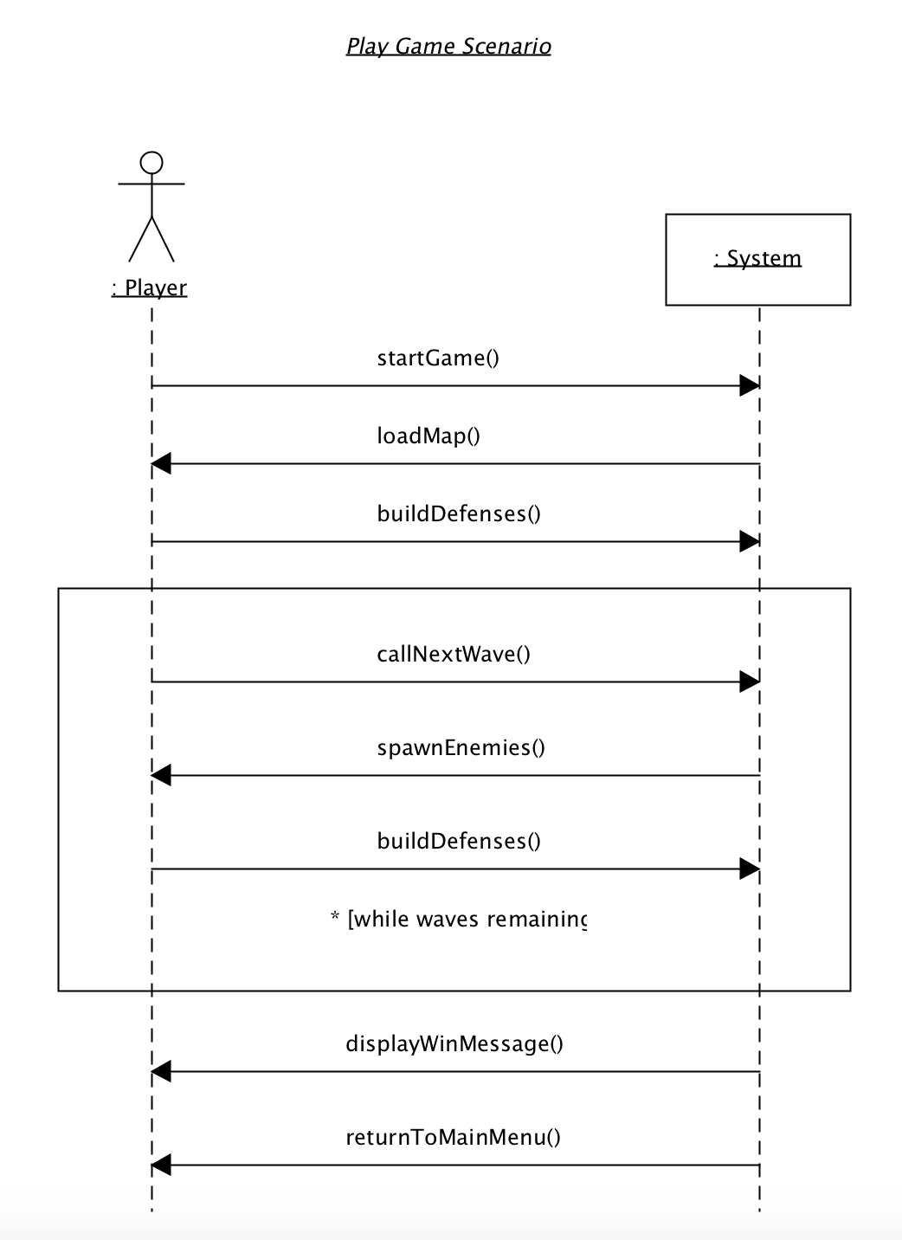
Sequence Diagram
UC 1: Play Game and extending use cases
described in a sequence diagram

Slide 7
Questions?

Slide 8
Thanks for your time!
Raphael Emberger
Stefan Bösch
Philipp Meier
Nicolas Eckhart

